Slide 1
HMH Science Dimensions
Biology
Unit 5: Cells: Stability and Change
Notes:
The learning experiences in this unit prepare students for the mastery of
Performance Expectations
LS1-4 Use a model to illustrate the role of cellular division (mitosis) and differentiation in producing and maintaining complex organisms.

Slide 2

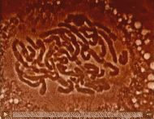
Cells: Stability and Change
Unit 5
This cell is preparing to divide by duplicating, organizing, and separating its chromosomes.

Slide 3

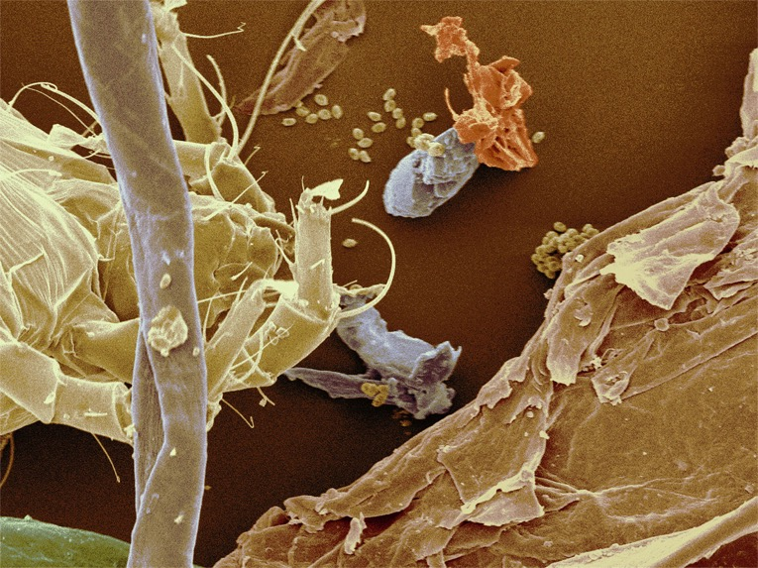

Cells: Stability and Change
Unit 5
How do you think multicellular organisms such as humans replace lost cells?
This scanning electron micrograph of household dust shows skin flakes, fabric fibers, part of a dead dust mite, and fungal spores.

Slide 4
Driving Questions
Unit 5
As you move through the unit, gather evidence to help you answer the following questions.
How do organisms balance the growth and division of their cells?
How do organisms replace lost or damaged cells?
Do all cells grow and divide in the same way? At the same rate?
How do organisms with many cell types develop from a single cell?

Slide 5

Unit Project
Unit 5
Cauliflower Cloning
How does the plant make new cells and structures?
What processes play roles in the formation of a new plant?

Slide 6
Unit Review
Unit 5
Synthesize the Unit
Make a concept map, other graphic organizer, or outline using the Study Guides you made for each lesson in this unit. Be sure to use evidence to support your claims.
When synthesizing individual information, remember to follow these general steps:
Find the central idea of each piece of information.
Think about the relationships among the central ideas.
Combine the ideas to come up with a new understanding.

Slide 7
Image Credits
Unit 5
cell mitosis video ©Encyclopaedia Britannica Films/Archive Films: Creative/Getty Images; micrograph of dust ©SCIMAT/Science Source

